Slide 1
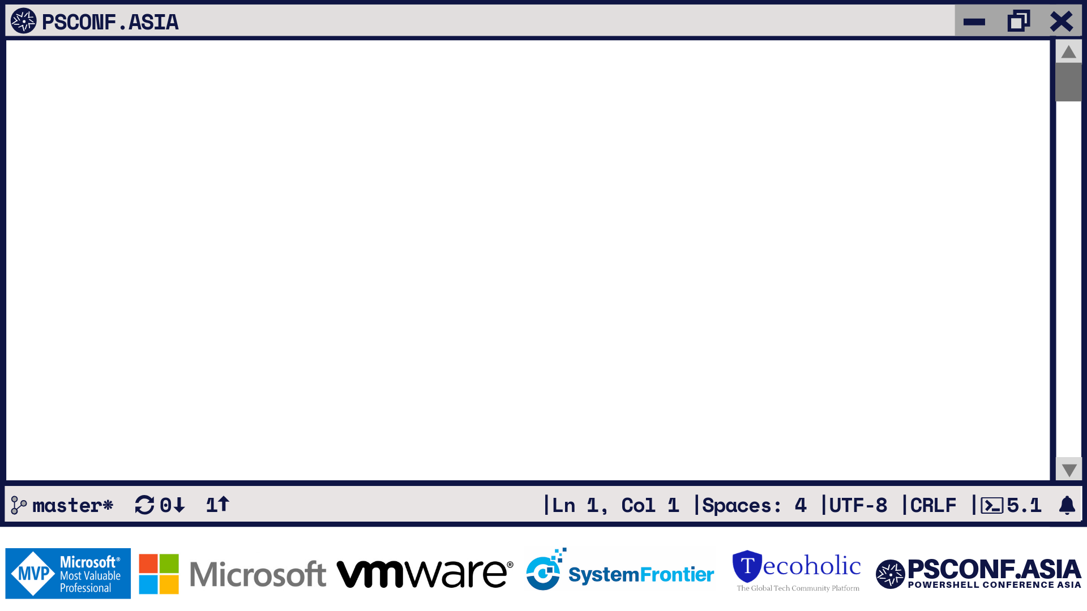
The State of the Shell
PowerShell 7 and Beyond
Sydney Smith Program Manager, Microsoft/PowerShell Team
7.0

Slide 2


Slide 6

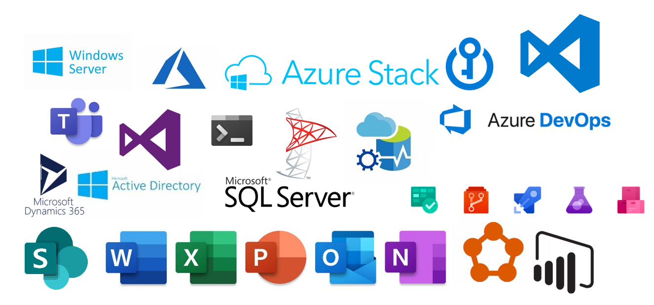
The Power of the Shell
PowerShell enables you to manage and automate your servers, clouds, hypervisors, networks, and much more!

Slide 7
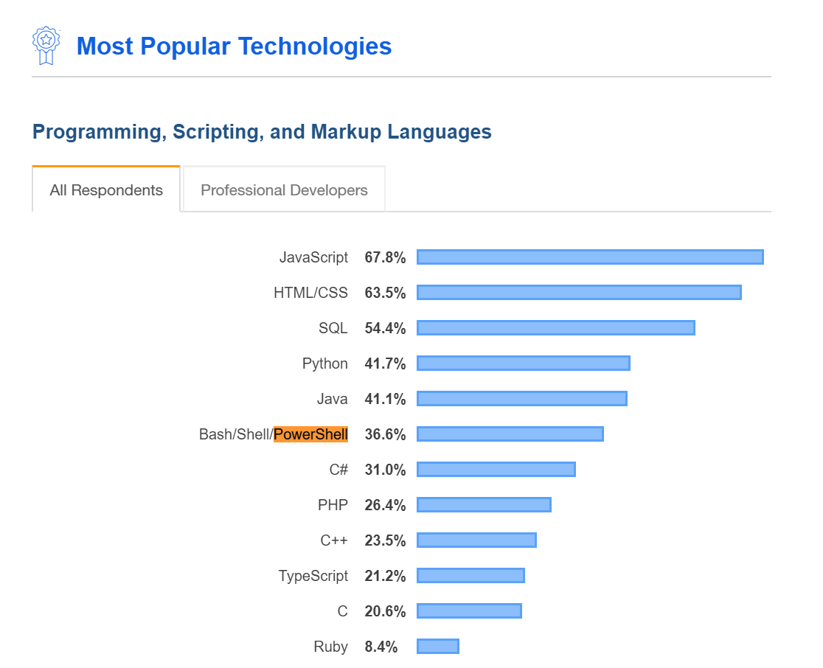

PowerShell Interest

Slide 8
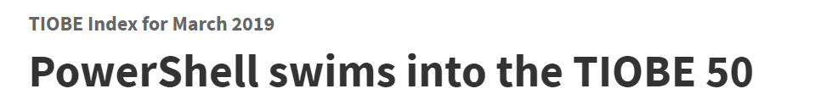


PowerShell Interest

Slide 9
PowerShell Themes
Ubiquity
PowerShell Core is supported on Linux, MacOS, and Windows
PowerShell in Cloud Shell enables Azure management from any browser or phone
PowerShell integration in VS Code, docs.microsoft.com, Azure services
Agility
Faster release cycles and transparent development
Direct interactions with the PowerShell team
PowerShell in Cloud Shell is maintained by Microsoft with latest tools
Community
Great OSS engagement
Tremendous usage of PowerShell Gallery for publishing and downloading PowerShell artifacts
User groups, PowerShell Conferences, Social media etc.

Slide 10



PowerShell Themes
Ubiquity
Agility
Community

Slide 11
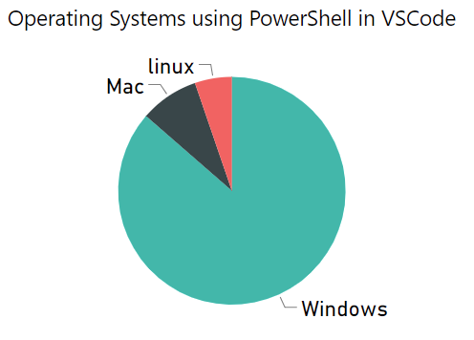
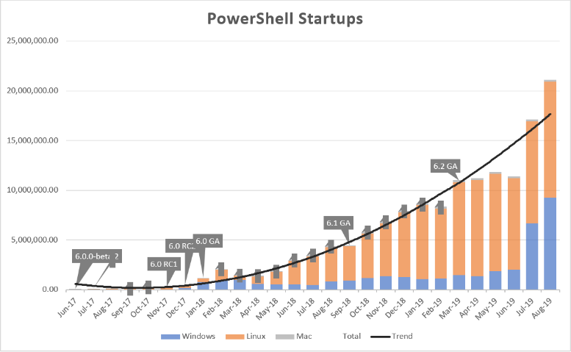
PowerShell Ubiquity

Slide 12



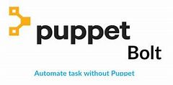



PowerShell Ubiquity- Cloud Shell
istioctl
https://docs.microsoft.com/en-us/azure/cloud-shell/features#tools

Slide 13
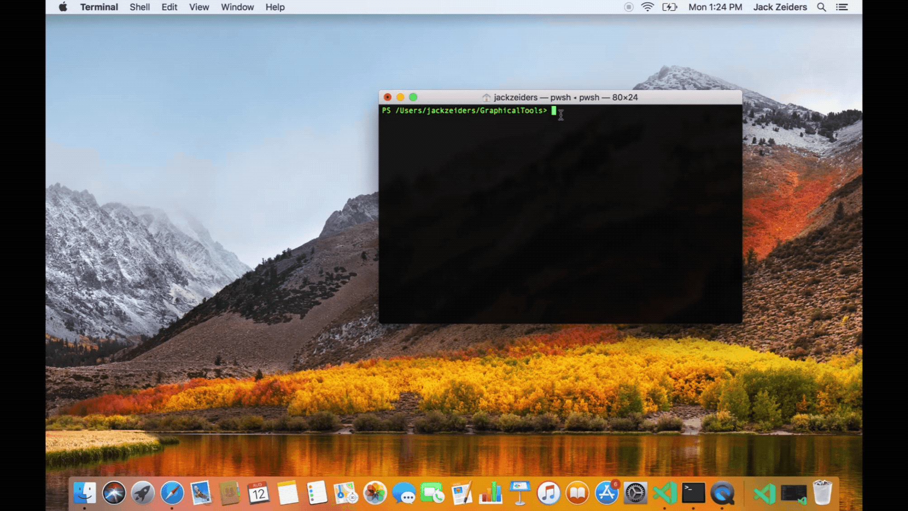
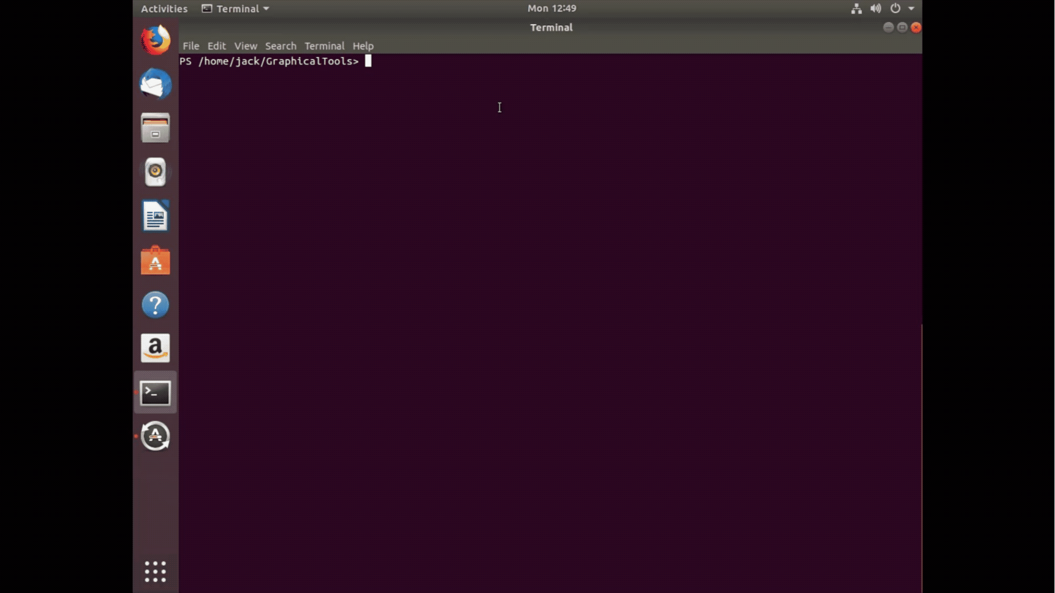
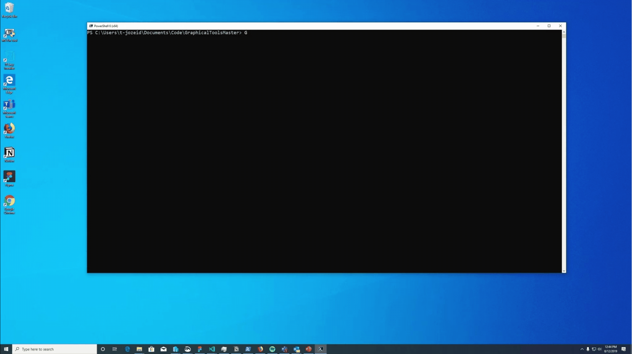
PowerShell Ubiquity- Out-Grid View
Install-Module Microsoft.PowerShell.GraphicalTools

Slide 14
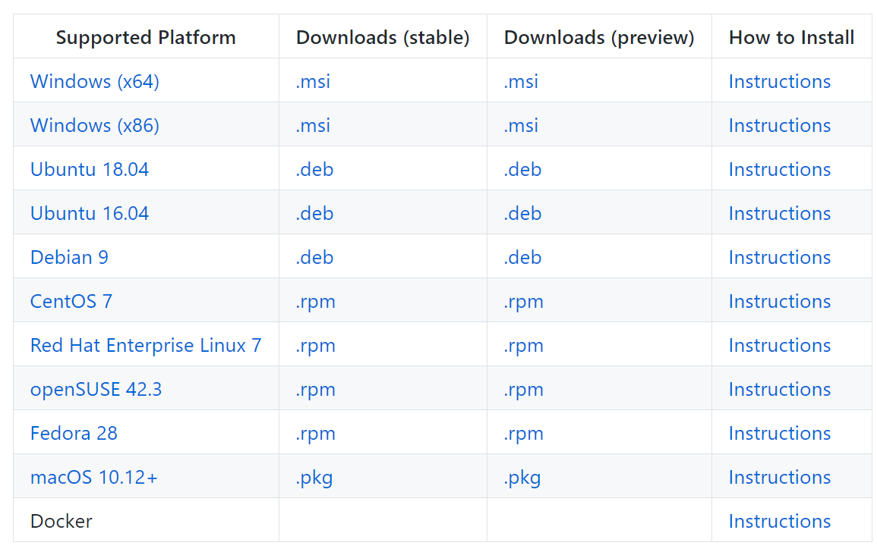
PowerShell Agility
$sb= [scriptblock]::Create((Invoke-WebRequest -Uri http://aka.ms/install-powershell.ps1).Content) & $sb -daily
C:\Users\sysmith\AppData\Local\Microsoft\powershell-daily\pwsh.exe

Slide 15
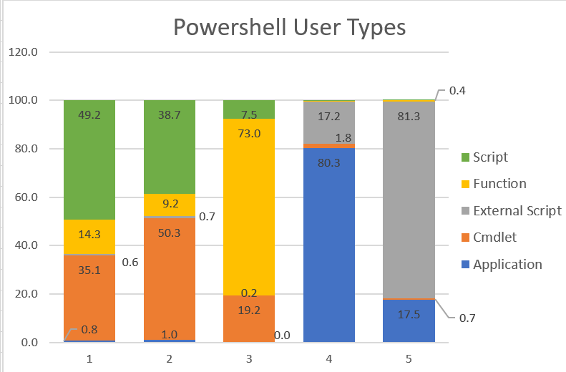
PowerShell Agility
Percentage of users: 61% 21% 14% 3% 1%

Slide 16
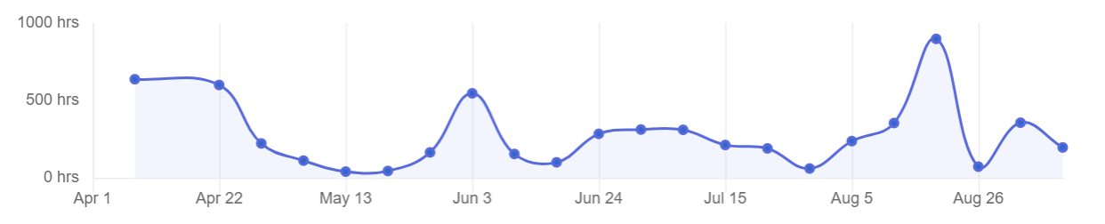
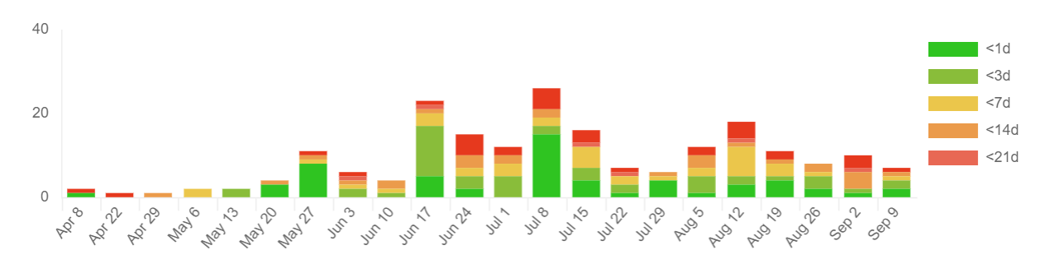
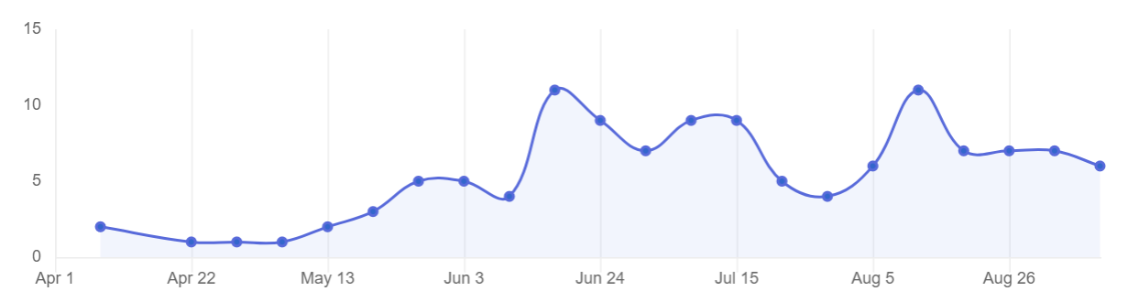
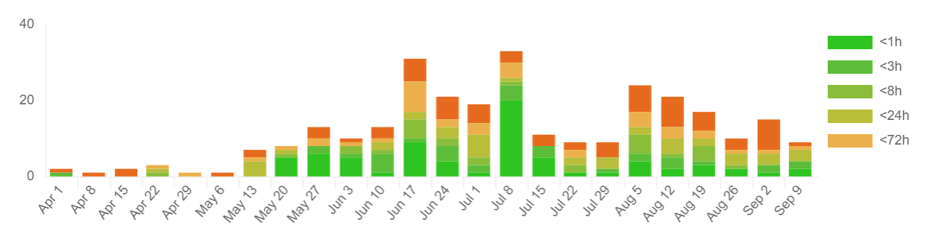
PowerShell Community
Average PR Merge Time
Breakdown of PR Merge Turnaround
Number of Contributors
Breakdown of PR Review Turnaround

Slide 17
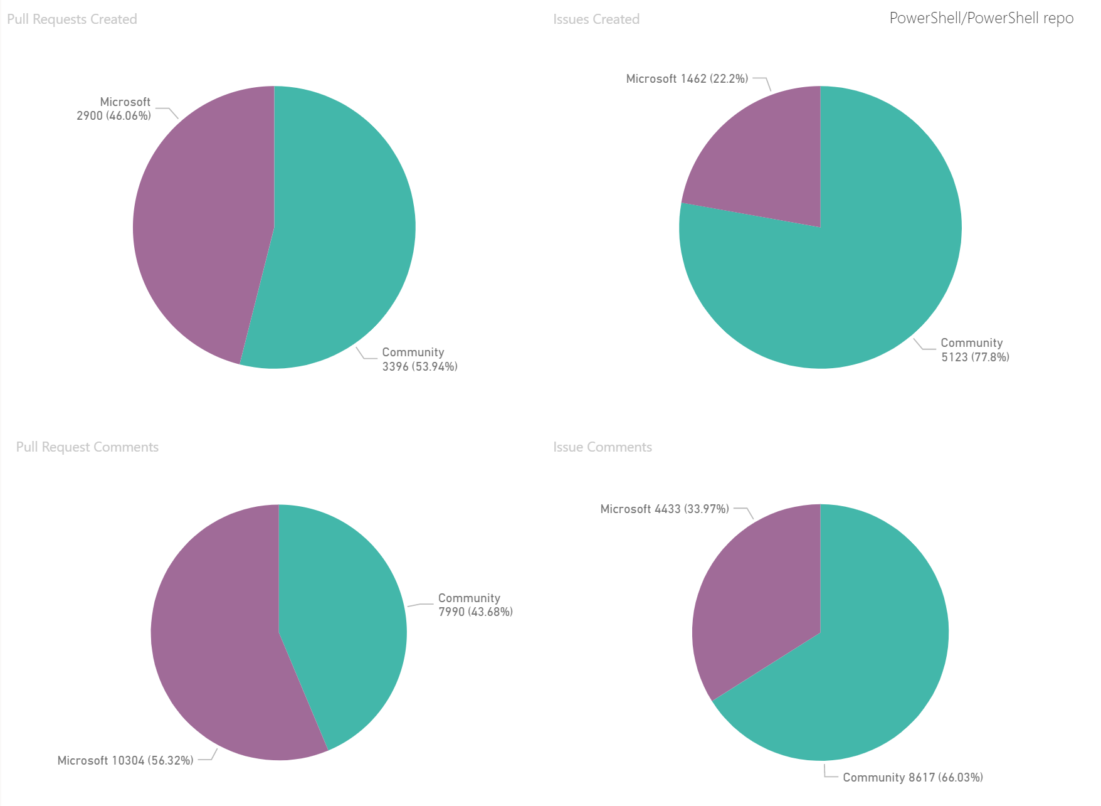
PowerShell Community
Pull Requests Created
Issues Created
Pull Request Comments
Issue
Comments

Slide 18
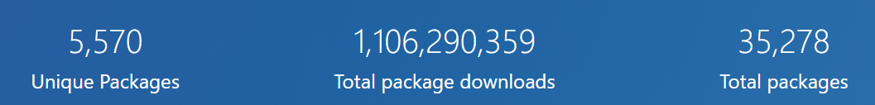
PowerShell Community

Slide 19









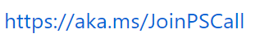
PowerShell Community

Slide 20
Shifts in Management
Windows PowerShell
PowerShell Core
Windows system mgmt.
Managed low-level infrastructure (e.g. Storage, Networking, etc.)
PowerShell managed disparate APIs on Windows
Cloud resource mgmt.
Heterogeneous world of REST APIs (e.g. Azure/ARM, other clouds, 3rd party SaaS services)
Lighter weight runtime optimized for containers/ephemeral runtimes
Cloud cadence requires agility in PowerShell
Native APIs
Win32
WMI/CIM
.NET APIs
XML
JSON
Data
CSV
Other clouds
SaaS
Azure

Slide 21
Windows PowerShell
Monad Manifesto - 2002
Built on .NET Framework
PowerShell 1.0 - 2006
PowerShell 2.0 – 2009
PowerShell 3.0 – 2012
Powershell 4.0 – 2013
PowerShell 5.0 – 2016
PowerShell 5.1 - 2016
Windows (exclusive) Management Tool

Slide 22
Windows PowerShell
PowerShell Core
PowerShell built on .NET Core
PowerShell Core 6.0 – Jan 10th, 2018
PowerShell Core 6.1 – Sept 13th, 2018
PowerShell Core 6.2 – March 28th 2019
Cross-platform
Run in whatever environment or OS makes sense for you
Self-contained and side-by-side
“No reboot” installation
Universal management platform independent of your OS
Open-source
Direct line to the PowerShell team
Share the collective contributions of the PowerShell community
Monad Manifesto - 2002
Built on .NET Framework
PowerShell 1.0 - 2006
PowerShell 2.0 – 2009
PowerShell 3.0 – 2012
PowerShell 4.0 – 2013
PowerShell 5.0 – 2016
PowerShell 5.1 - 2016
Windows (exclusive) Management Tool

Slide 23
Windows PowerShell
PowerShell Core
PowerShell 7
PowerShell built on .NET Core
PowerShell Core 6.0 – Jan 10th, 2018
PowerShell Core 6.1 – Sept 13th, 2018
PowerShell Core 6.2 – March 28th 2019
Cross-platform
Run in whatever environment or OS makes sense for you
Self-contained and side-by-side
“No reboot” installation
Universal management platform independent of your OS
Open-source
Direct line to the PowerShell team
Share the collective contributions of the PowerShell community
PowerShell built on .NET Core 3.0
PowerShell 7.0- targeted for Jan 2020
Cross-platform
Run in whatever environment or OS makes sense for you
Open-source
Direct line to the PowerShell team
Share the collective contributions of the PowerShell community
Tool for cloud/hybrid environments
Full Windows Management Tool
Viable full Windows PowerShell Replacement
Monad Manifesto - 2002
Built on .NET Framework
PowerShell 1.0 - 2006
PowerShell 2.0 – 2009
PowerShell 3.0 – 2012
Powershell 4.0 – 2013
PowerShell 5.0 – 2016
PowerShell 5.1 - 2016
Windows (exclusive) Management Tool

Slide 24
PowerShell 7 Milestone
Windows PS Compatibility
Additional module validation
Windows PowerShell wrapper
.NET Core 3.1
Available in Windows Store
Affinity to the Cloud
Secrets management
Cloud Shell
Docker Distributions
Great Tooling
PSReadLine 2.0
PowerShellEditorServices 2.0
Telemetry++
PowerShellGet 3.0
Top Customer Requests
Local policy support
Invoke-DscResource
ForEach-Object –Parallel
Updated ErrorView
New version notification
Ternary operator
Chain operators (&& and ||)
Null conditional assignment

Slide 25
PowerShell 7 Milestone
Windows PS Compatibility
Additional module validation
Windows PowerShell wrapper
.NET Core 3.1
Available in Windows Store
Affinity to the Cloud
Secrets management
Cloud Shell
Docker Distributions
Great Tooling
PSReadLine 2.0
PowerShellEditorServices 2.0
Telemetry++
PowerShellGet 3.0
Top Customer Requests
Local policy support
Invoke-DscResource
ForEach-Object –Parallel
Updated ErrorView
New version notification
Ternary operator
Chain operators (&& and ||)
Null conditional assignment

Slide 26
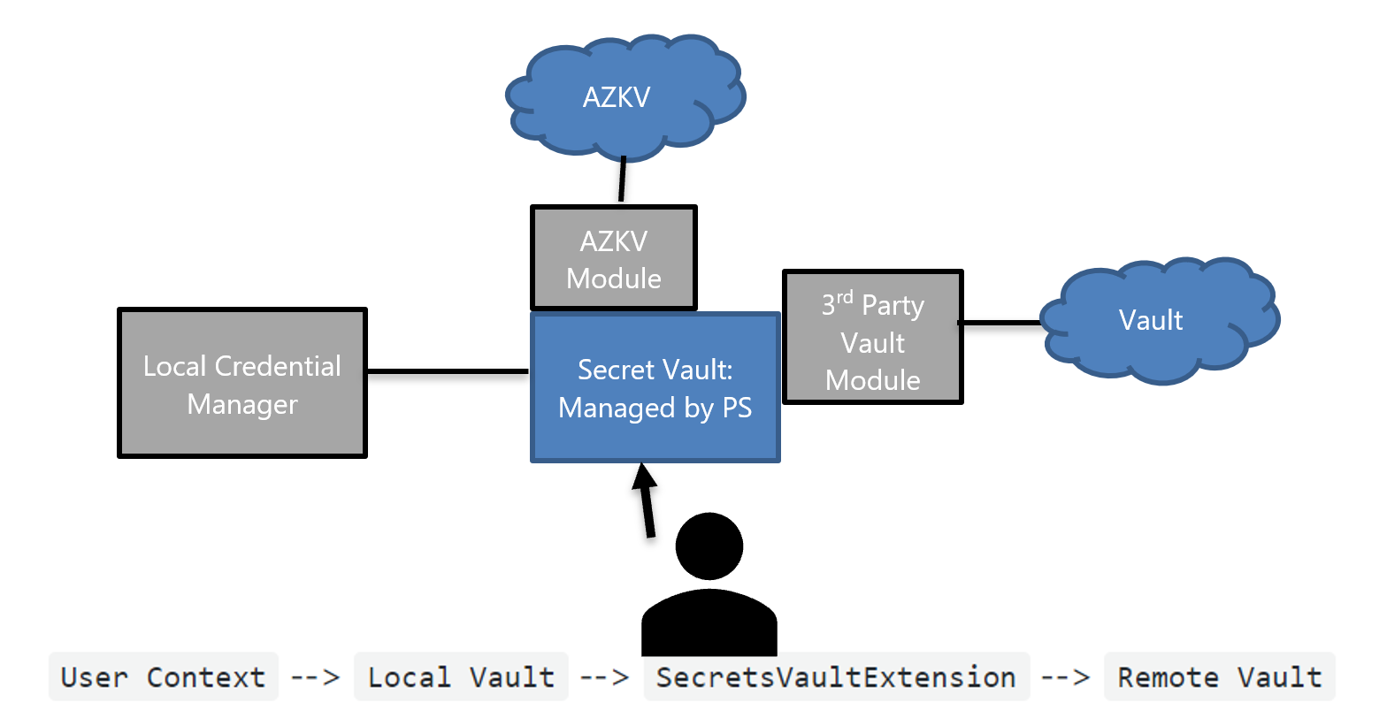
Secrets Management
It is difficult to manage secrets securely in heterogeneous cloud environments
Advanced scripts that touch many systems require multiple secrets and types of secrets when orchestrating across different clouds
Custom code is required to securely manage secrets across platforms
High stakes because of security implications
Secrets supported:
PSCredential
SecureString
String
HashTable
Byte[]

Slide 27
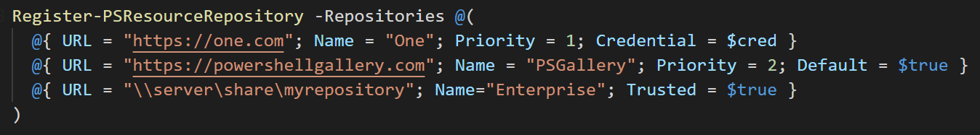
PowerShellGet 3.0
Rewrite of PowerShellGet in C# to reduce complexity and make easier to maintain
Removes dependencies on PackageManagement and nuget.exe
PowerShellGet 2.X and PowerShellGet 3.0 can coexist side-by-side
Addresses top customer and performance complaints of PowerShellGet

Slide 28
PSReadLine 2.0
Address long-standing accessibility and globalization issues
Fix series of edge-case crashes and keyboard layout issues
Delivering inbox to Windows PowerShell 5.1 in latest Win10

Slide 29
Demo: ForEach–Object -Parallel

Slide 30
Demo: Experimental Features

Slide 31
PowerShell 7-Preview 4 – Just Shipped Today!
Engine Updates and Fixes
Add support to ActionPreference.Break to break into debugger when Debug, Error, Information, Progress, Verbose or Warning messages are generated (#8205) (Thanks @KirkMunro!)
Enable starting control panel add-ins within PowerShell Core without specifying .CPL extension. (#9828)
Performance
Make ForEach-Object faster for its commonly used scenarios (#10454) and fix ForEach-Object -Parallel performance problem with many runspaces (#10455)
Experimental Features
Update PSDesiredStateConfiguration module version to 2.0.3 and bring new tests; enable compilation to MOF on non-Windows and use of Invoke-DSCResource without LCM (#10516)
Add APIs for breakpoint management in runspaces and enable attach to process without BreakAll for PowerShell Editor Services (#10338) (Thanks @KirkMunro!)
Support ternary operator in PowerShell language (#10367)
General Cmdlet Updates and Fixes
Add PowerShell Core group policy definitions (#10468)
Update console host to support XTPUSHSGR/XTPOPSGR VT control sequences that are used in composability scenarios. (#10208)
Add WorkingDirectory parameter to Start-Job (#10324) (Thanks @davinci26!)
Remove the event handler that was causing breakpoint changes to be erroneously replicated to the host runspace debugger (#10503) (Thanks @KirkMunro!)
Replace api-ms-win-core-job-12-1-0.dll with Kernell32.dll in Microsoft.PowerShell.Commands.NativeMethods P/Invoke API(#10417) (Thanks @iSazonov!)
Fix wrong output for New-Service in variable assignment and -OutVariable (#10444) (Thanks @kvprasoon!)
Fix global tool issues around exit code, command line parameters and path with spaces (#10461)
Fix recursion into OneDrive - change FindFirstFileEx() to use SafeFindHandle type (#10405)
Skip auto-loading PSReadLine on Windows if the NVDA screen reader is active (#10385)
Increase built-with-PowerShell module versions to 7.0.0.0 (#10356)
Add throwing an error in Add-Type if a type with the same name already exists (#9609) (Thanks @iSazonov!)
Code Cleanup
Convert ActionPreference.Suspend enumeration value into a non-supported, reserved state, and remove restriction on using ActionPreference.Ignore in preference variables (#10317) (Thanks @KirkMunro!)
Replace ArrayList with List<T> to get more readable and reliable code without changing functionality (#10333) (Thanks @iSazonov!)
Make code style fixes to TestConnectionCommand (#10439) (Thanks @vexx32!)
Cleanup AutomationEngine and remove extra SetSessionStateDrive method call (#10416) (Thanks @iSazonov!)
Rename default ParameterSetName back to Delimiter for ConvertTo-Csv and ConvertFrom-Csv (#10425)
Tools
Update install-powershell.ps1 to check for already installed daily build (#10489)
https://devblogs.microsoft.com/powershell/powershell-7-preview-4/

Slide 32
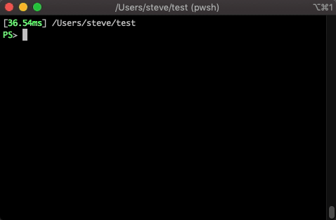
Invoke-DSCResource
Invoke-DscResource [-Name] <string> [-Method] <string> -ModuleName <ModuleSpecification> -Property <hashtable> [<CommonParameters>]

Slide 33
Demo: Ternary Operator
Notes:
Start with simple

Slide 34
Demo: Set $ErrorAction Breakpoint

Slide 35
What’s next?
Look for new updates to:
PS Script Analyzer (1.8.3 shipped on Monday)
VSCode Extension (2019.09.0 shipping soon)
PSReadLine (2.0.0-beta5 shipped last week)
Cloud Shell (ships every two weeks)
Preview of PowerShellGet 3.0 (targeted for Dec 2019)
PowerShell 7--preview 5 – Mid October
PowerShell 7--preview 6 – Mid November
PowerShell 7 Release candidate December
PowerShell 7 targeted for January 2020

Slide 36
